Slide 1
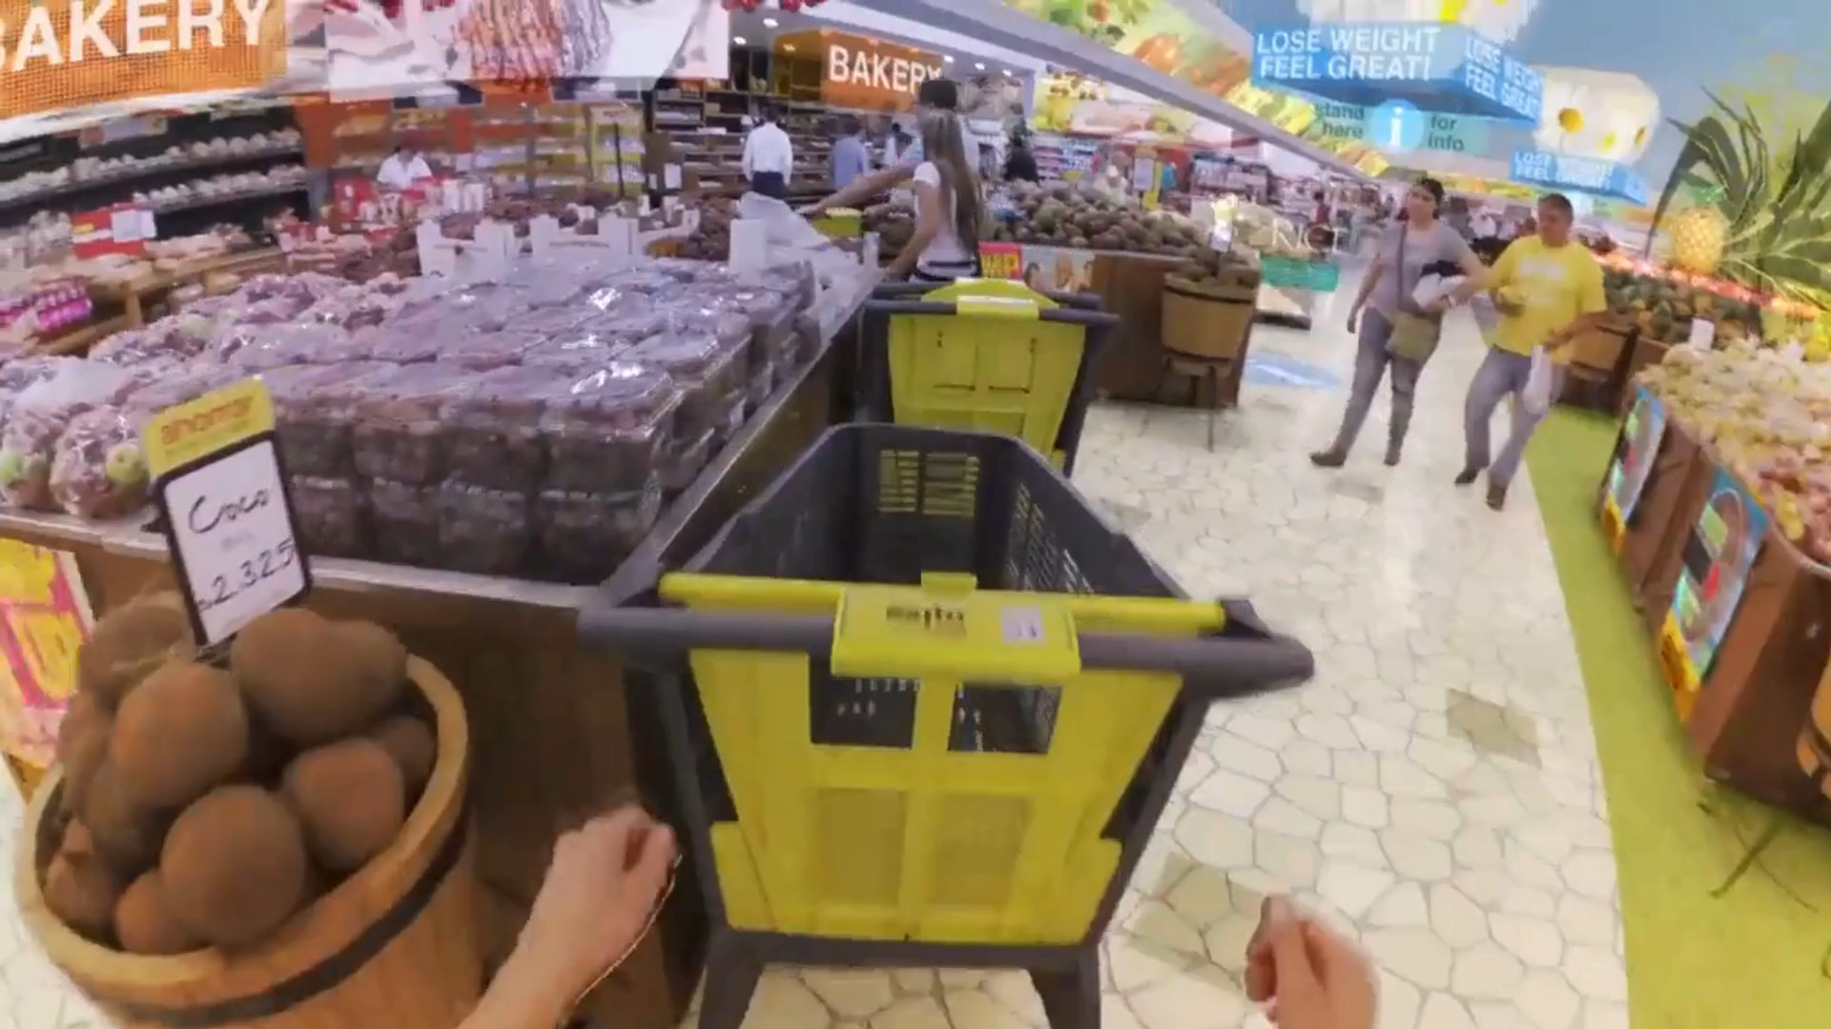

Slide 2



Next-Gen Shopping: Augmented Reality Meets Retail

Slide 3
3
SMART Framework
SMART Framework
4
Objective
AI Assistance
1
2
5
8
9
Introduction
SMART Framework
Conclusion
SMART Framework
6
7
SMART Framework

Slide 4

1
Introduction
Augmented reality and Ai revolutionize shopping and retailing, enhancing user experience and performance

Slide 5
3
SMART Framework
SMART Framework
4
Objective
AI Assistance
1
2
5
8
9
Introduction
SMART Framework
Conclusion
SMART Framework
6
7
SMART Framework

Slide 6
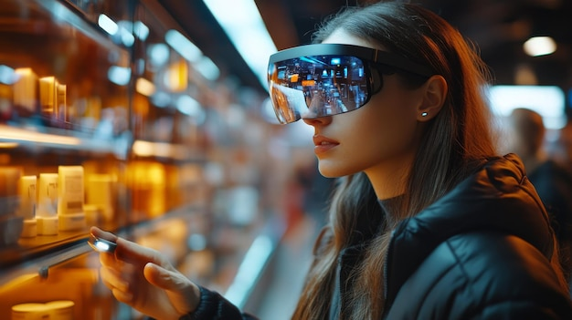

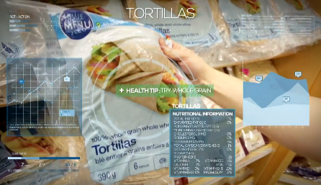
2
Objective
Enhance User Experience in shopping.
Offers Personalized Shopping based on user preferences.
Improve Convenience with user friendly interface.
Boost Engagement using interactive features and animations.

Slide 7
3
SMART Framework
SMART Framework
4
Objective
AI Assistance
1
2
5
8
9
Introduction
SMART Framework
Conclusion
SMART Framework
6
7
SMART Framework

Slide 8
3
Smart Framework
Specific:
Develop a augmented reality shopping platform with detailed product visualization for the users, also gives suggestion on what product to buy based on user preference for a better shopping experience.

Slide 9
3
SMART Framework
SMART Framework
4
Objective
AI Assistance
1
2
5
8
9
Introduction
SMART Framework
Conclusion
SMART Framework
6
7
SMART Framework

Slide 10

4
Smart Framework
Measurable:
Implement data analytics to track user engagement metrics such as number of products viewed, completion rate of shopping process.
Achieve a 25% improvement in user engagement through the analysis of user interactions and feedback.

Slide 11
3
SMART Framework
SMART Framework
4
Objective
AI Assistance
1
2
5
8
9
Introduction
SMART Framework
Conclusion
SMART Framework
6
7
SMART Framework

Slide 12
5
Smart Framework
Achievable:
Ensure that the technology required for augmented reality shopping tracker prototype is currently available and feasible within the project’s budget and timeline. Collaborate with experienced AR developers, conduct regular feasibility assessments, and adapt the project plan as needed to address challenges

Slide 13
3
SMART Framework
SMART Framework
4
Objective
AI Assistance
1
2
5
8
9
Introduction
SMART Framework
Conclusion
SMART Framework
6
7
SMART Framework

Slide 14

6
Smart Framework
Relevant:
Ensure that the project Aligns with current e-commerce trends and address the increasing demand for interactive and uninterrupted shopping experience.
Prioritize features that directly contribute to the user’s taste and overall shopping preference.

Slide 15
3
SMART Framework
SMART Framework
4
Objective
AI Assistance
1
2
5
8
9
Introduction
SMART Framework
Conclusion
SMART Framework
6
7
SMART Framework

Slide 16

7
Smart Framework
Time Bound:
Develop, test, and launch the augmented reality shopping tracker with in a 9month timeframe.
Establish milestones, such as completing prototype development within the first 2 months, conducting feasibility test with in 6months, and launching the final product by 9th month.

Slide 17
3
SMART Framework
SMART Framework
4
Objective
AI Assistance
1
2
5
8
9
Introduction
SMART Framework
Conclusion
SMART Framework
6
7
SMART Framework

Slide 18

8
AI Assistance
AI assistance analyzes shopping preferences and behaviors, providing personalized recommendations and real-time product suggestions, ensuring a tailored and efficient shopping experience

Slide 19
3
SMART Framework
SMART Framework
4
Objective
AI Assistance
1
2
5
8
9
Introduction
SMART Framework
Conclusion
SMART Framework
6
7
SMART Framework

Slide 20
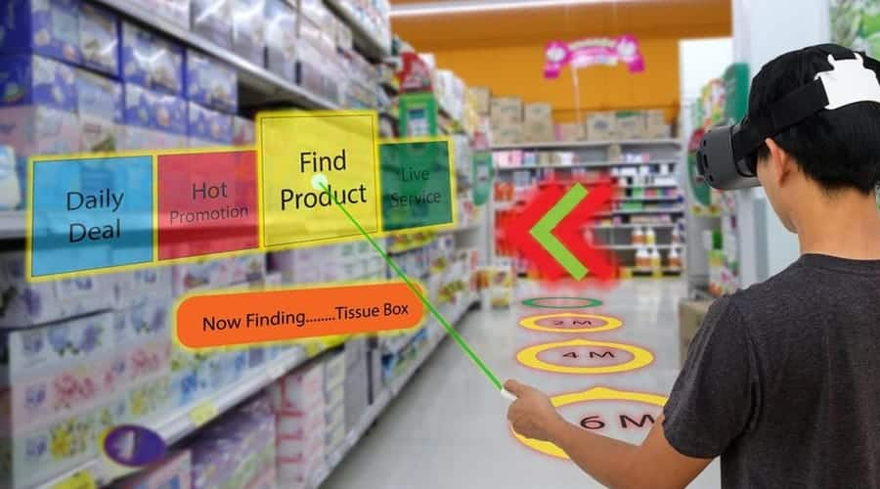
9
Conclusion
Augmented Reality and AI redefines shopping, offering an immersive, and efficient retail experience.
This technology enhances convenience and creates a dynamic shopping environment tailored to individual preferences.

Slide 21


